Slide 1
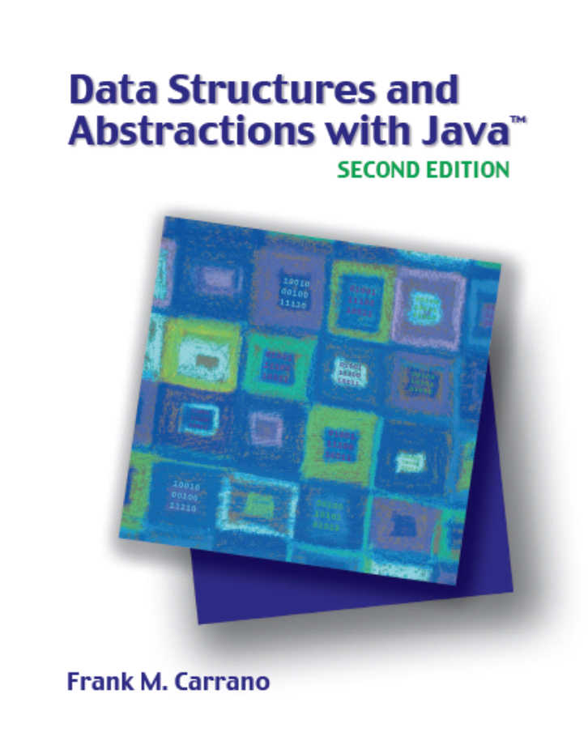

Stacks
Chapter 21
Slides by Steve Armstrong
LeTourneau University
Longview, TX
© 2007, Prentice Hall

Slide 2
Chapter Contents
Specifications of the ADT(abstract data type) Stack
Using a Stack to Process Algebraic Expressions
  Checking for Balanced Parentheses, Brackets, and Braces in an Infix Algebraic Expression
  Transforming an Infix Expression to a Postfix Expression
  Evaluating Postfix Expressions
  Evaluating Infix Expressions
Carrano, Data Structures and Abstractions with Java, Second Edition, (c) 2007 Pearson Education, Inc. All rights reserved. 0-13-237045-X

Slide 3
Chapter Contents
The Program Stack
  Recursive Methods
Using a Stack Instead of Recursion
  An Iterative Binary Search
Java Class Library: The Class Stack
Carrano, Data Structures and Abstractions with Java, Second Edition, (c) 2007 Pearson Education, Inc. All rights reserved. 0-13-237045-X

Slide 4
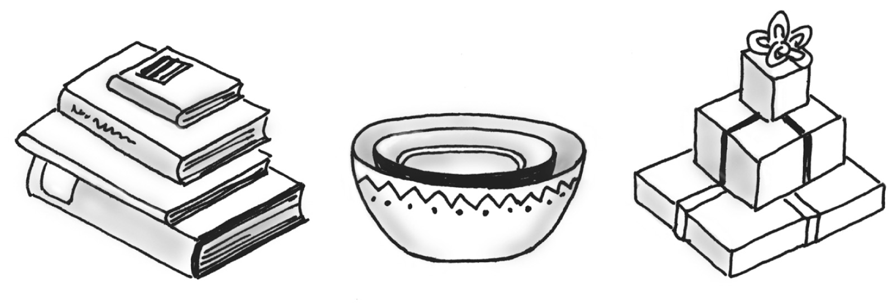
Specifications of the ADT Stack
Organizes entries according to order in which added
Additions are made to one end, the top
The item most recently added is always on the top
Fig. 21-1 Some familiar stacks.
Carrano, Data Structures and Abstractions with Java, Second Edition, (c) 2007 Pearson Education, Inc. All rights reserved. 0-13-237045-X

Slide 5
Specifications of the ADT Stack
Abstract Data Type Stack – operations
  push(newEntry)
  pop()
  peek()
  isEmpty()
  clear()
Carrano, Data Structures and Abstractions with Java, Second Edition, (c) 2007 Pearson Education, Inc. All rights reserved. 0-13-237045-X

Slide 6
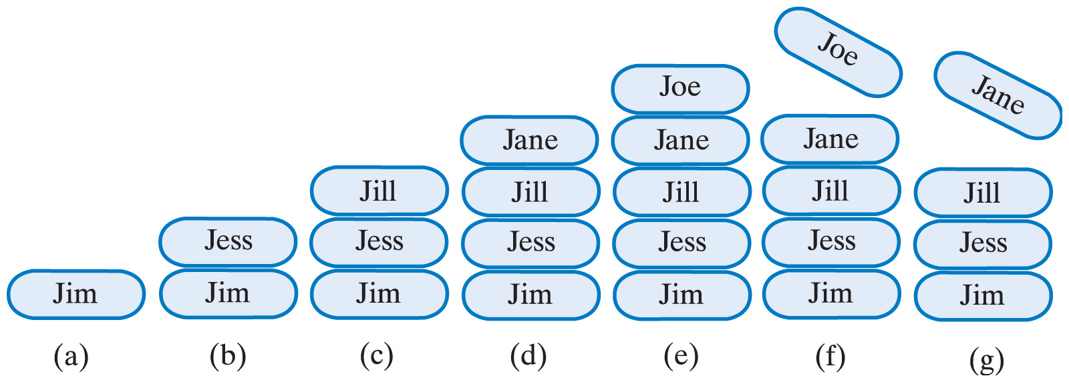
Specifications of the ADT Stack
Fig. 21-2 A stack of strings after (a) push adds Jim;
(b) push adds Jess; (c) push adds Jill; (d) push adds Jane; (e) push adds Joe; (f) pop retrieves and removes Joe; (g) pop retrieves and removes Jane
Carrano, Data Structures and Abstractions with Java, Second Edition, (c) 2007 Pearson Education, Inc. All rights reserved. 0-13-237045-X

Slide 7
Using a Stack to Process Algebraic Expressions
Infix expressions
  Binary operators appear between operands
  a + b
Prefix expressions
  Binary operators appear before operands
  + a b
Postfix expressions
  Binary operators appear after operands
  a b +
  Easier to process – no need for parentheses nor precedence
Carrano, Data Structures and Abstractions with Java, Second Edition, (c) 2007 Pearson Education, Inc. All rights reserved. 0-13-237045-X

Slide 8
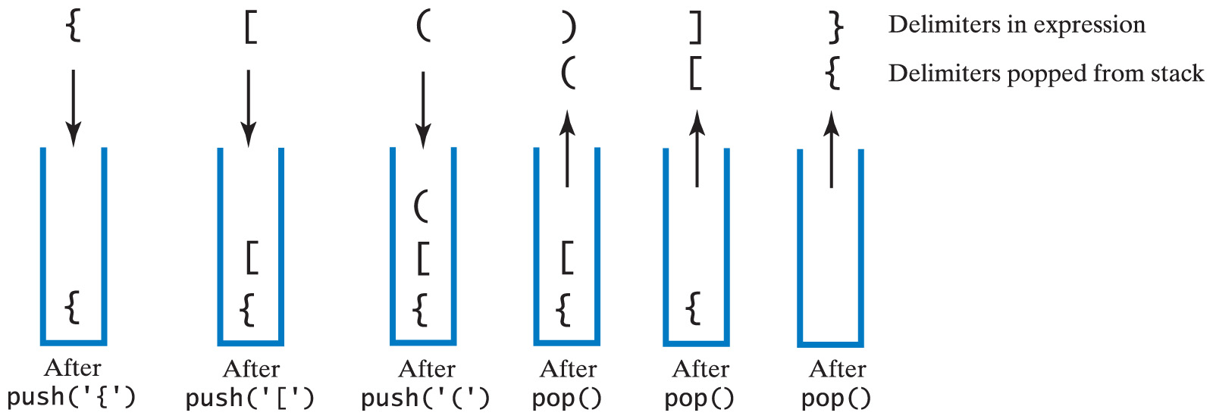
Checking for Balanced (), [], {}
Fig. 21-3 The contents of a stack during the scan of an expression that contains the balanced delimiters {[()]}
Carrano, Data Structures and Abstractions with Java, Second Edition, (c) 2007 Pearson Education, Inc. All rights reserved. 0-13-237045-X

Slide 9
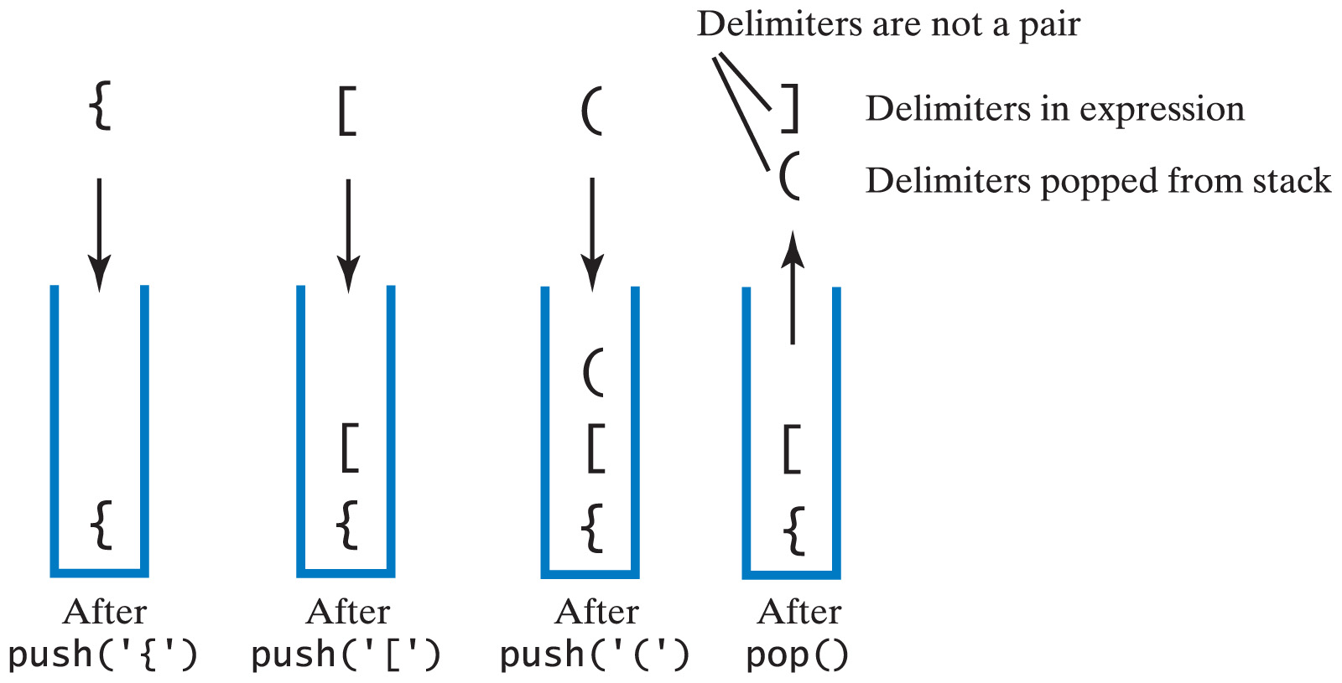
Checking for Balanced (), [], {}
Fig. 21-4 The contents of a stack during the scan of an expression that contains the unbalanced delimiters {[(])}
Carrano, Data Structures and Abstractions with Java, Second Edition, (c) 2007 Pearson Education, Inc. All rights reserved. 0-13-237045-X

Slide 10
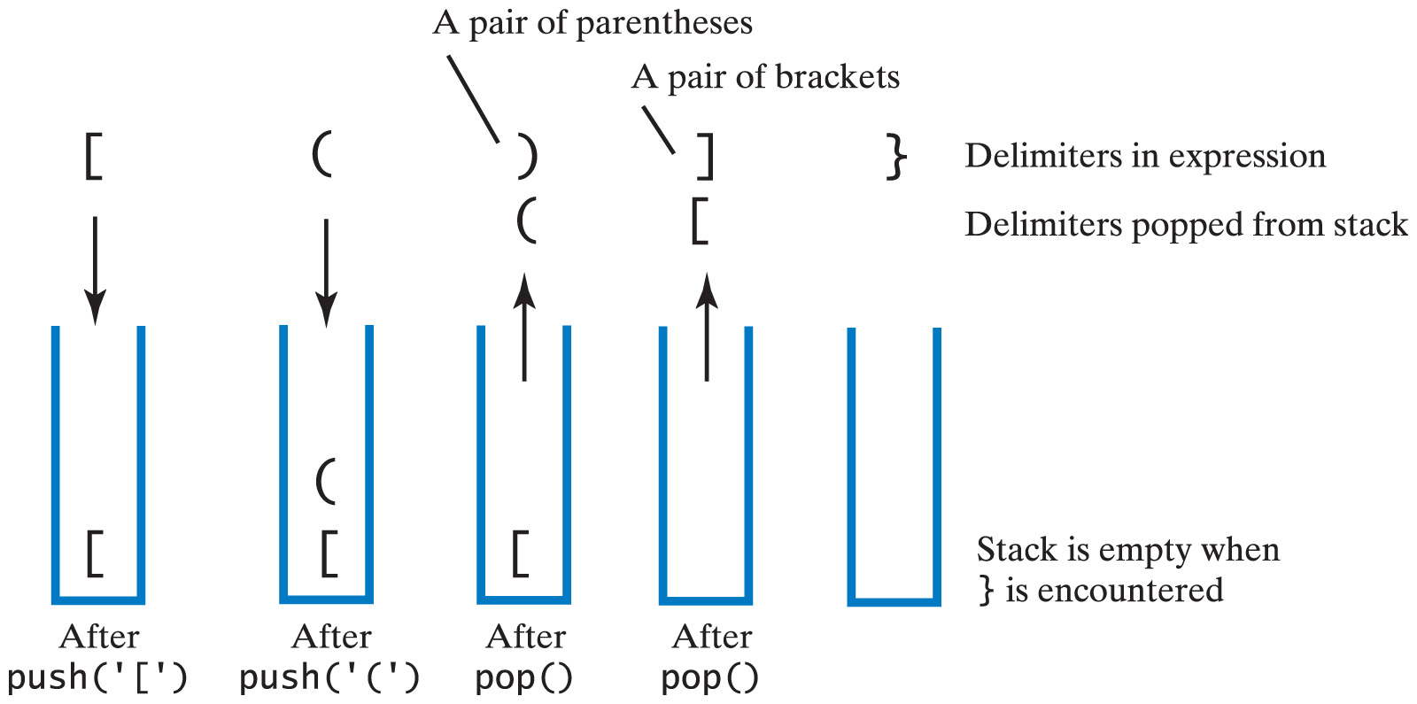
Checking for Balanced (), [], {}
Fig. 21-5 The contents of a stack during the scan of an expression that contains the unbalanced delimiters [()]}
Carrano, Data Structures and Abstractions with Java, Second Edition, (c) 2007 Pearson Education, Inc. All rights reserved. 0-13-237045-X

Slide 11
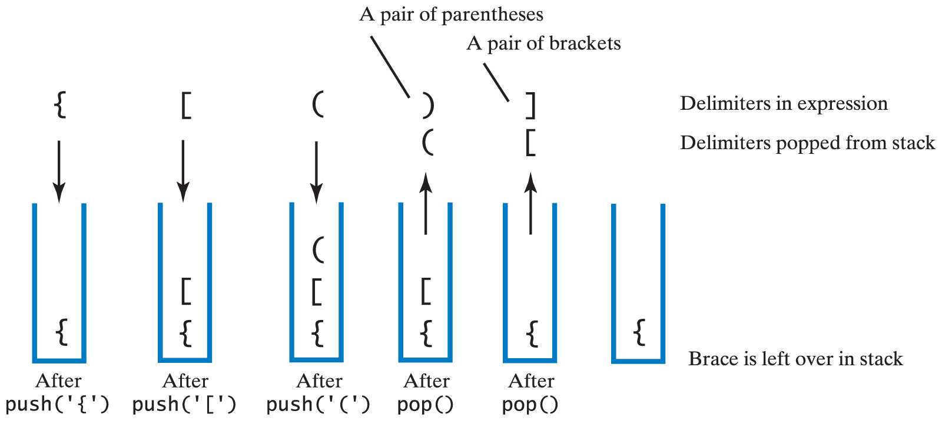
Checking for Balanced (), [], {}
Fig. 21-6 The contents of a stack during the scan of an expression that contains the unbalanced delimiters {[()]
Carrano, Data Structures and Abstractions with Java, Second Edition, (c) 2007 Pearson Education, Inc. All rights reserved. 0-13-237045-X

Slide 12
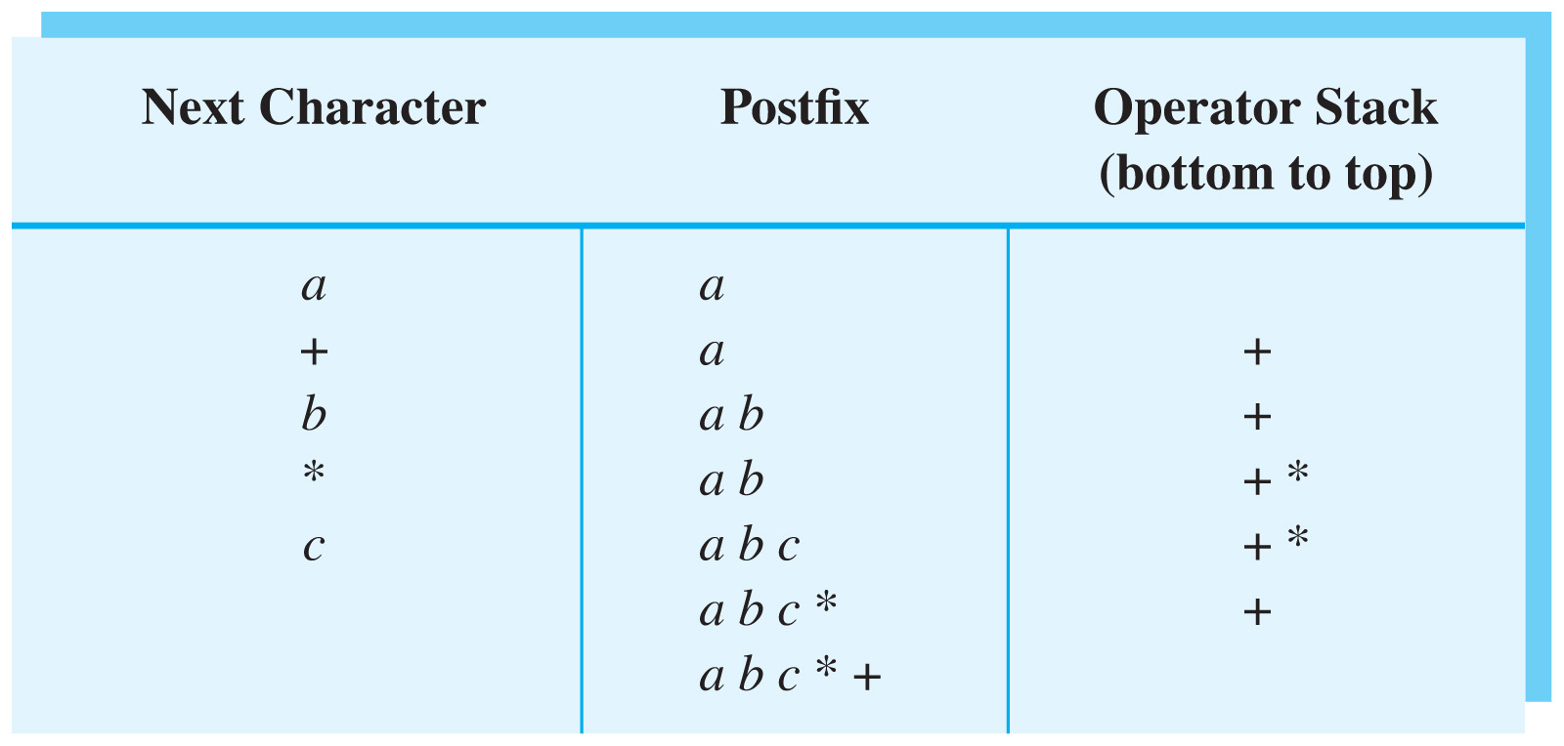
Transforming Infix to Postfix
Fig. 21-7 Converting the infix expression
a + b * c to postfix form
Carrano, Data Structures and Abstractions with Java, Second Edition, (c) 2007 Pearson Education, Inc. All rights reserved. 0-13-237045-X

Slide 13
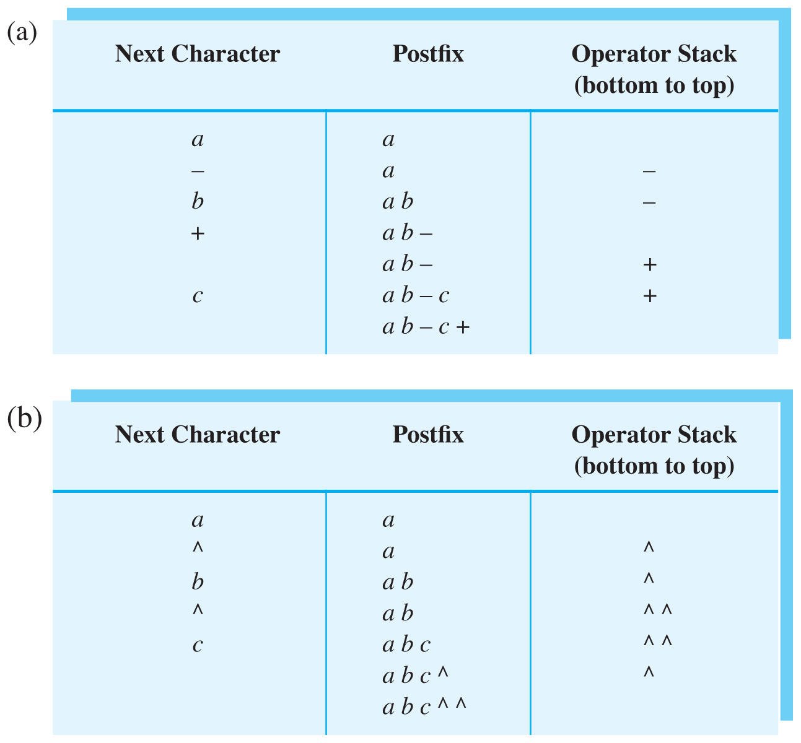
Transforming Infix to Postfix
Fig. 21-8(a) Converting infix expression to postfix form: a – b + c
Carrano, Data Structures and Abstractions with Java, Second Edition, (c) 2007 Pearson Education, Inc. All rights reserved. 0-13-237045-X

Slide 14
Transforming Infix to Postfix
Fig. 21-8(b) Converting infix expression to postfix form: a ^ b ^ c
Carrano, Data Structures and Abstractions with Java, Second Edition, (c) 2007 Pearson Education, Inc. All rights reserved. 0-13-237045-X

Slide 15
Infix-to-Postfix Algorithm
Symbol in Infix | Action
Operand | Append to end of output expression
Operator ^ | Push ^ onto stack
Operator +,-, *, or / | Pop operators from stack, append to output expression until stack empty or top has lower precedence than new operator. Then push new operator onto stack
Open parenthesis | Push ( onto stack
Close parenthesis | Pop operators from stack, append to output expression until we pop an open parenthesis. Discard both parentheses.
Carrano, Data Structures and Abstractions with Java, Second Edition, (c) 2007 Pearson Education, Inc. All rights reserved. 0-13-237045-X

Slide 16
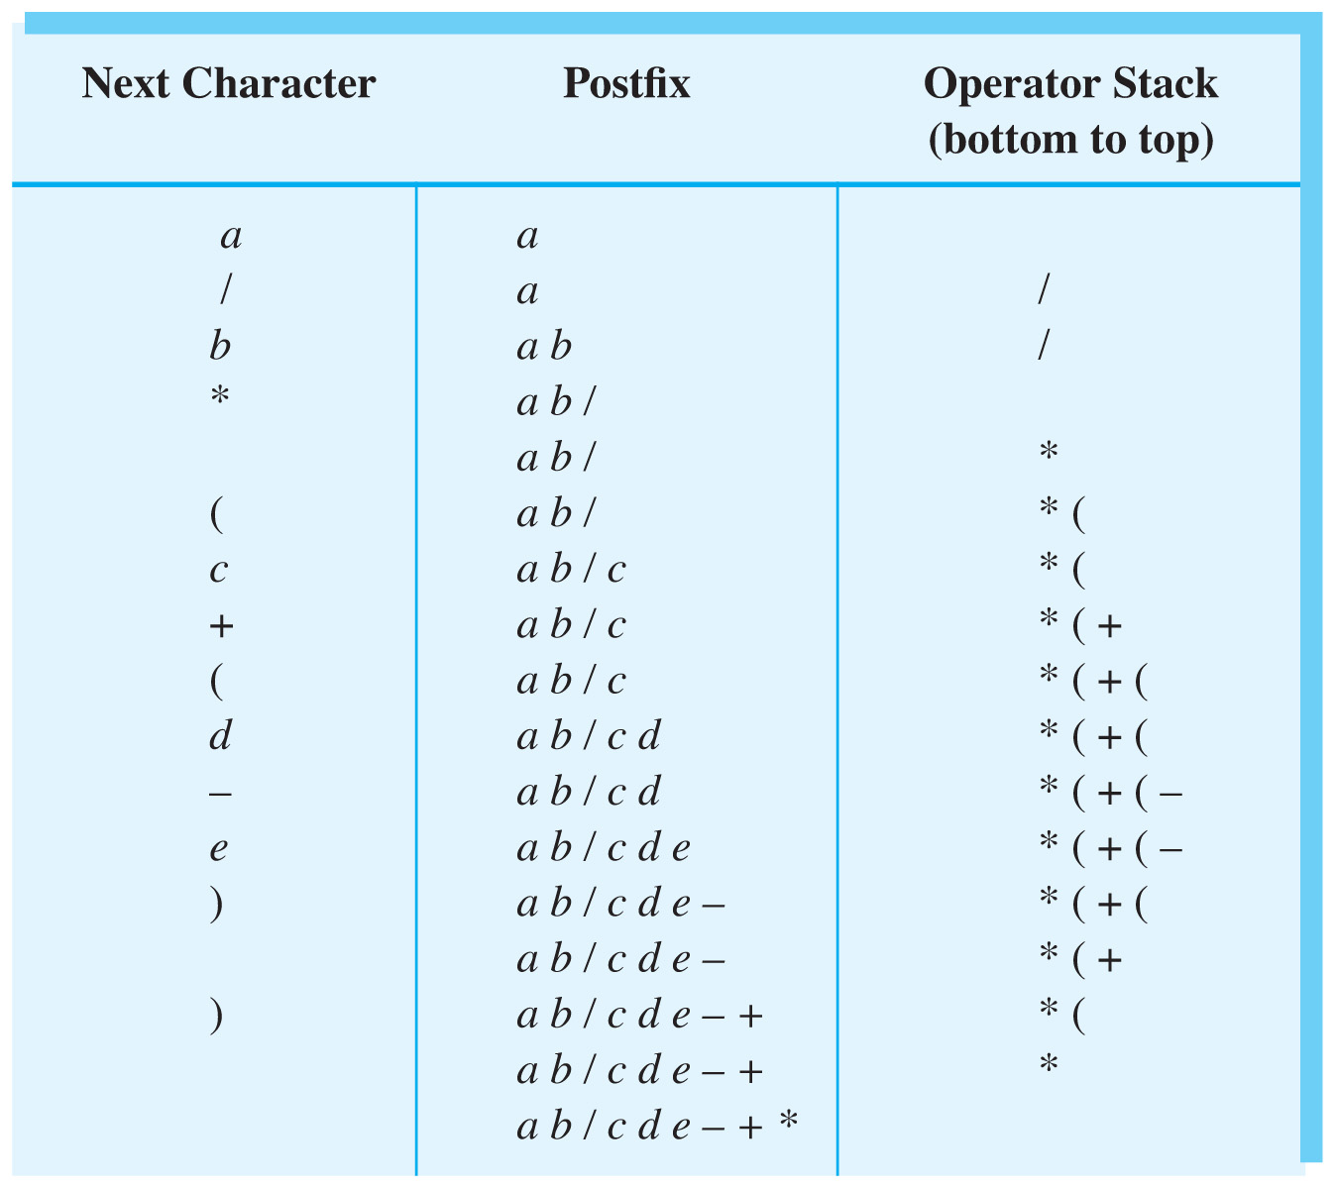
Transforming Infix to Postfix
Fig. 21-9 Steps to convert the infix expression
a / b * ( c + ( d – e ) ) to postfix form.
Carrano, Data Structures and Abstractions with Java, Second Edition, (c) 2007 Pearson Education, Inc. All rights reserved. 0-13-237045-X

Slide 17
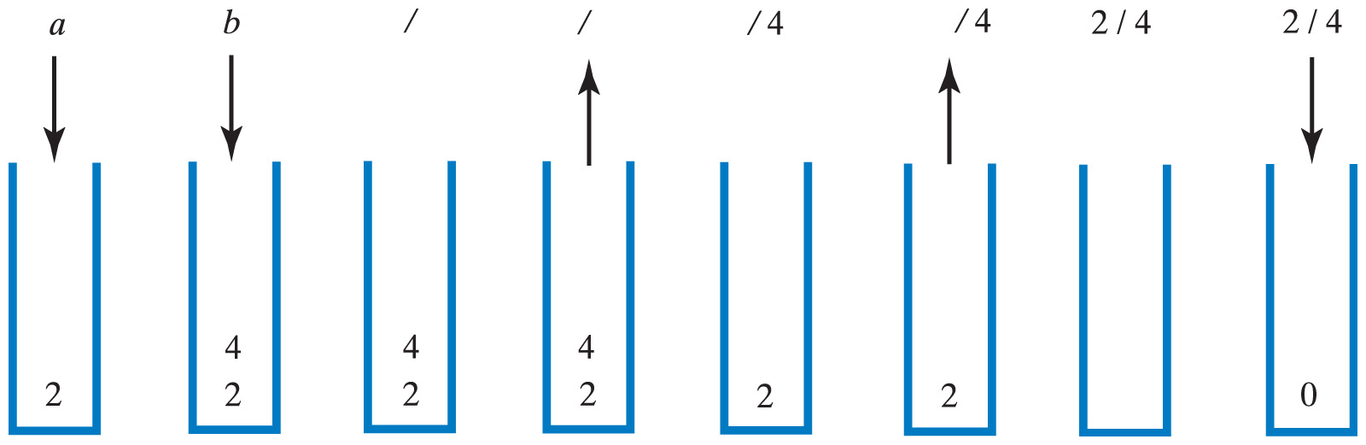
Evaluating Postfix Expression
Fig. 21-10 The stack during the evaluation of the postfix expression a b / when a is 2 and b is 4
Carrano, Data Structures and Abstractions with Java, Second Edition, (c) 2007 Pearson Education, Inc. All rights reserved. 0-13-237045-X

Slide 18
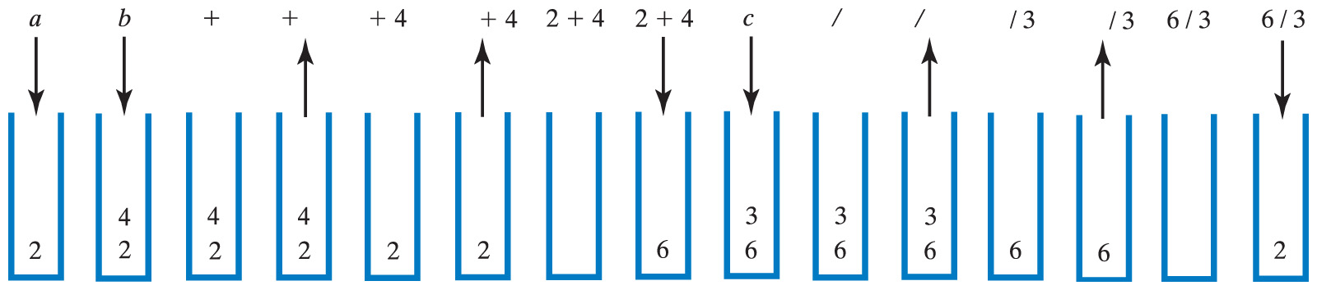
Evaluating Postfix Expression
Fig. 21-11 The stack during the evaluation of the postfix expression a b + c / when a is 2, b is 4 and c is 3
Click to view postfix evaluation algorithm
Carrano, Data Structures and Abstractions with Java, Second Edition, (c) 2007 Pearson Education, Inc. All rights reserved. 0-13-237045-X

Slide 19
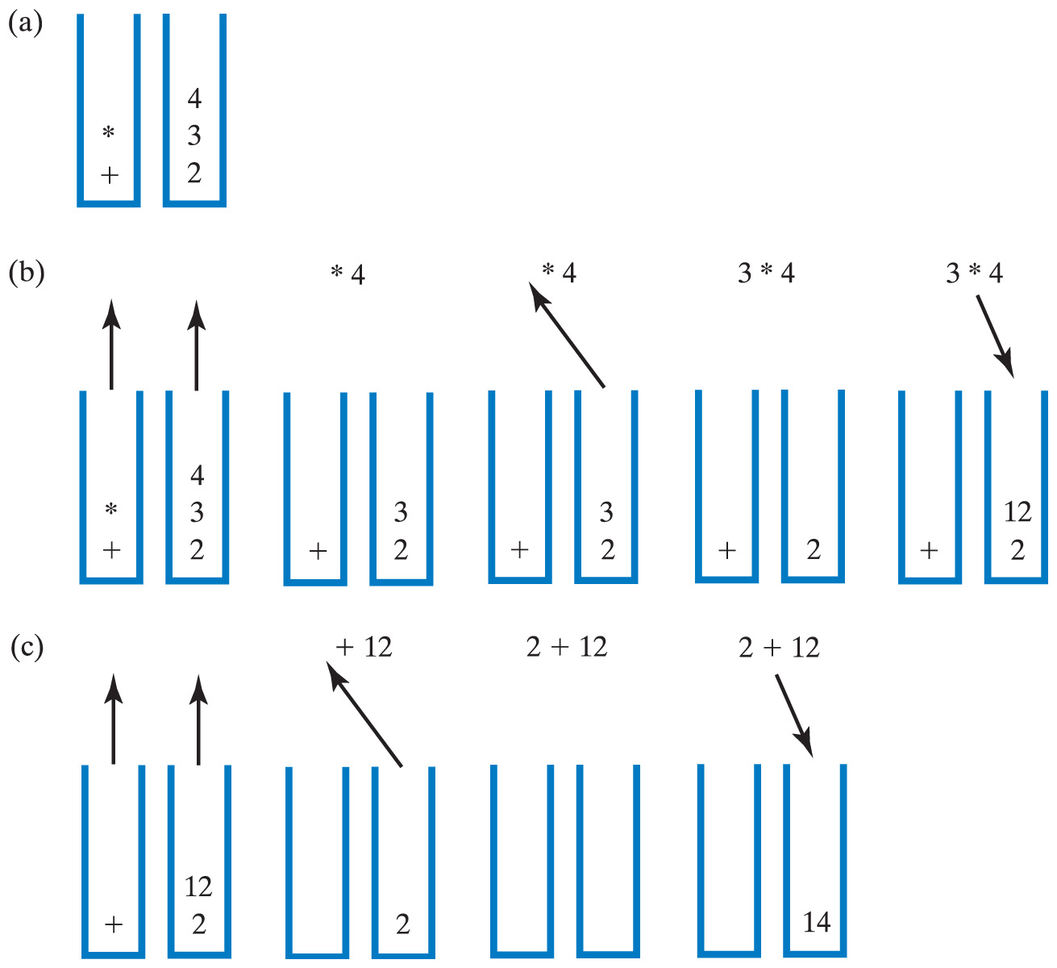
Evaluating Infix Expressions
Click to view algorithm for evaluating infix
Fig. 21-12 Two stacks during evaluation of a + b * c when
a = 2, b = 3, c = 4; (a) after reaching end of expression;
(b) while performing multiplication;
(c) while performing the addition
Carrano, Data Structures and Abstractions with Java, Second Edition, (c) 2007 Pearson Education, Inc. All rights reserved. 0-13-237045-X

Slide 20
The Program Stack
When a method is called
  Runtime environment creates activation record
  Shows method's state during execution
Activation record pushed onto the program stack (Java stack)
  Top of stack belongs to currently executing method
  Next method down is the one that called current method
Carrano, Data Structures and Abstractions with Java, Second Edition, (c) 2007 Pearson Education, Inc. All rights reserved. 0-13-237045-X

Slide 21
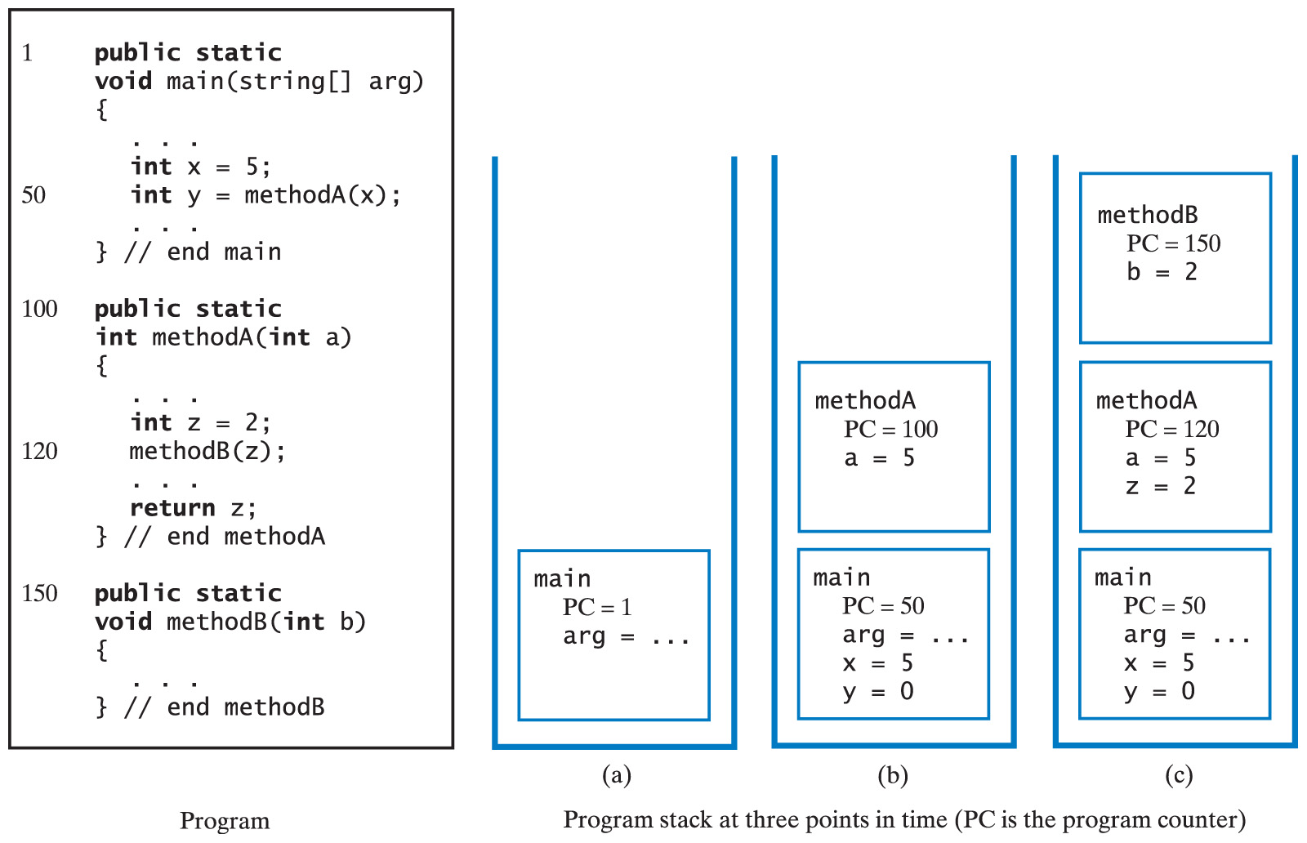
The Program Stack
Fig. 21-13 The program stack at 3 points in time; (a) when main begins execution; (b) when methodA begins execution, (c) when methodB begins execution.
Carrano, Data Structures and Abstractions with Java, Second Edition, (c) 2007 Pearson Education, Inc. All rights reserved. 0-13-237045-X

Slide 22
Recursive Methods
A recursive method making many recursive calls
  Places many activation records in the program stack
  Thus the reason recursive methods can use much memory
Possible to replace recursion with iteration by using a stack
Carrano, Data Structures and Abstractions with Java, Second Edition, (c) 2007 Pearson Education, Inc. All rights reserved. 0-13-237045-X

Slide 23
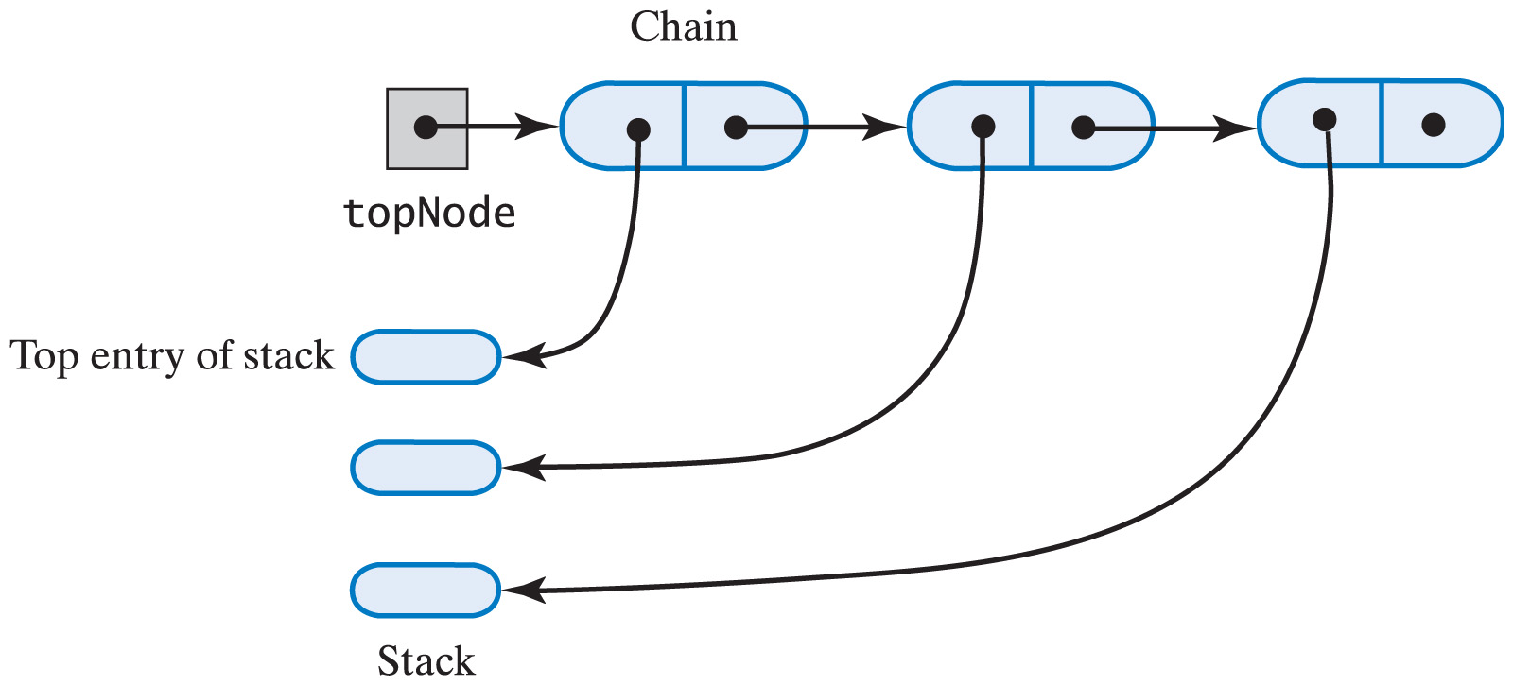
A Linked Implementation
When using a chain of linked nodes to implement a stack
  The first node should reference the stack's top
Fig. 22-1 A chain of linked nodes that implements a stack.
Carrano, Data Structures and Abstractions with Java, Second Edition, (c) 2007 Pearson Education, Inc. All rights reserved. 0-13-237045-X

Slide 24
A Linked Implementation
View source code of class for stack implemented by linked list
Note methods
  push
  peek
  pop
  isEmpty
  clear
Carrano, Data Structures and Abstractions with Java, Second Edition, (c) 2007 Pearson Education, Inc. All rights reserved. 0-13-237045-X

Slide 25
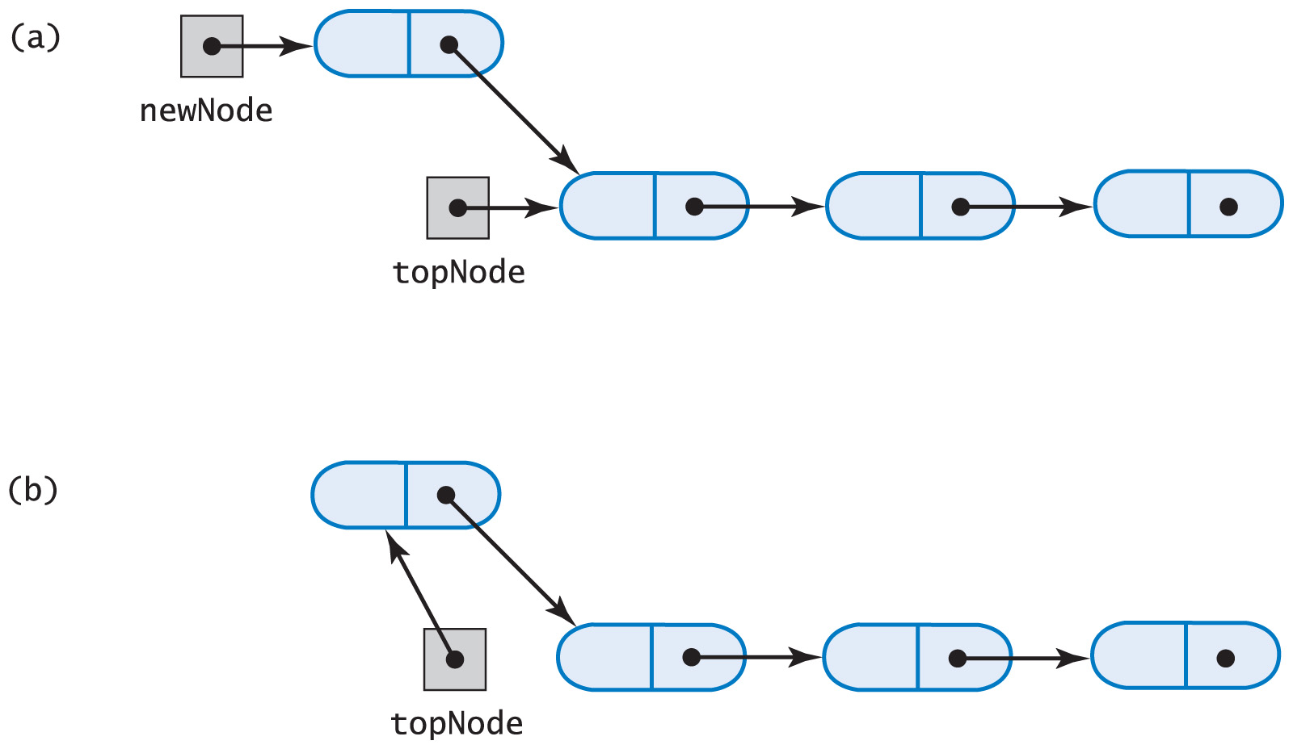
A Linked Implementation
Fig. 22-2 (a) A new node that references the top of the stack; (b) the new node is now at the top of the stack.
Carrano, Data Structures and Abstractions with Java, Second Edition, (c) 2007 Pearson Education, Inc. All rights reserved. 0-13-237045-X

Slide 26
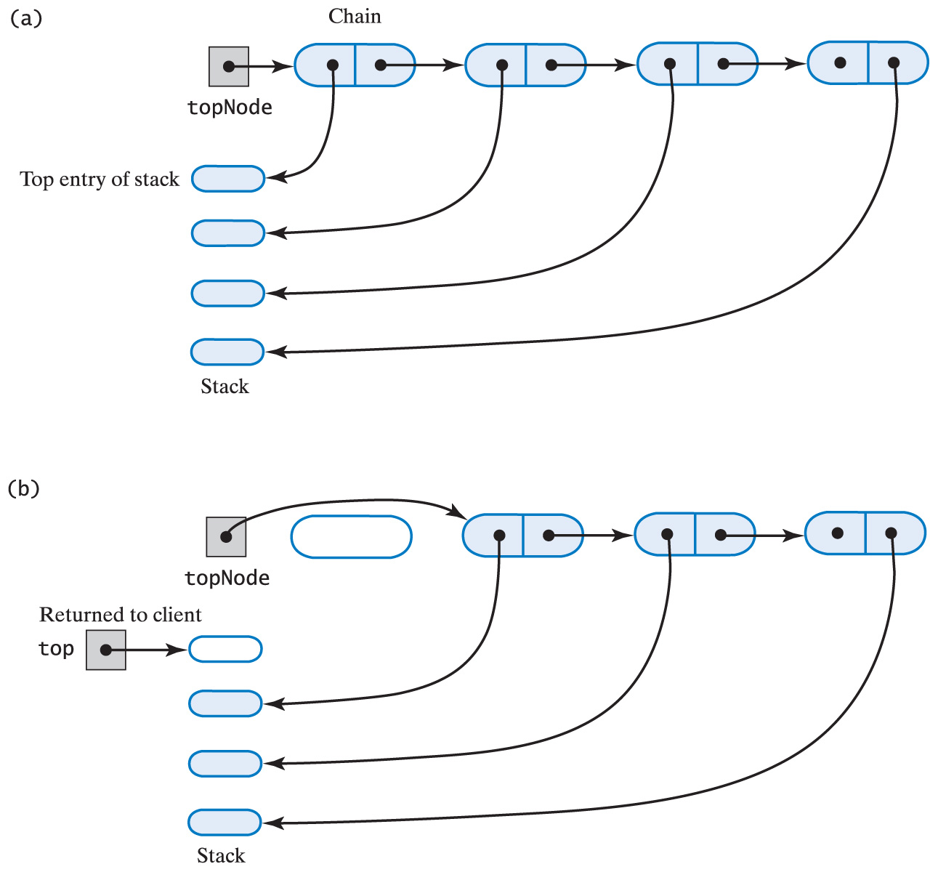
A Linked Implementation
Fig. 22-3 The stack (a) before the first node in the chain is deleted
Carrano, Data Structures and Abstractions with Java, Second Edition, (c) 2007 Pearson Education, Inc. All rights reserved. 0-13-237045-X

Slide 27
A Linked Implementation
Fig. 22-3 The stack (b) after the first node in the chain is deleted
Carrano, Data Structures and Abstractions with Java, Second Edition, (c) 2007 Pearson Education, Inc. All rights reserved. 0-13-237045-X

Slide 28
An Array-Based Implementation
When using an array to implement a stack
  The array's first element should represent the bottom of the stack
  The last occupied location in the array represents the stack's top
This avoids shifting of elements of the array if it were done the other way around
Carrano, Data Structures and Abstractions with Java, Second Edition, (c) 2007 Pearson Education, Inc. All rights reserved. 0-13-237045-X

Slide 29
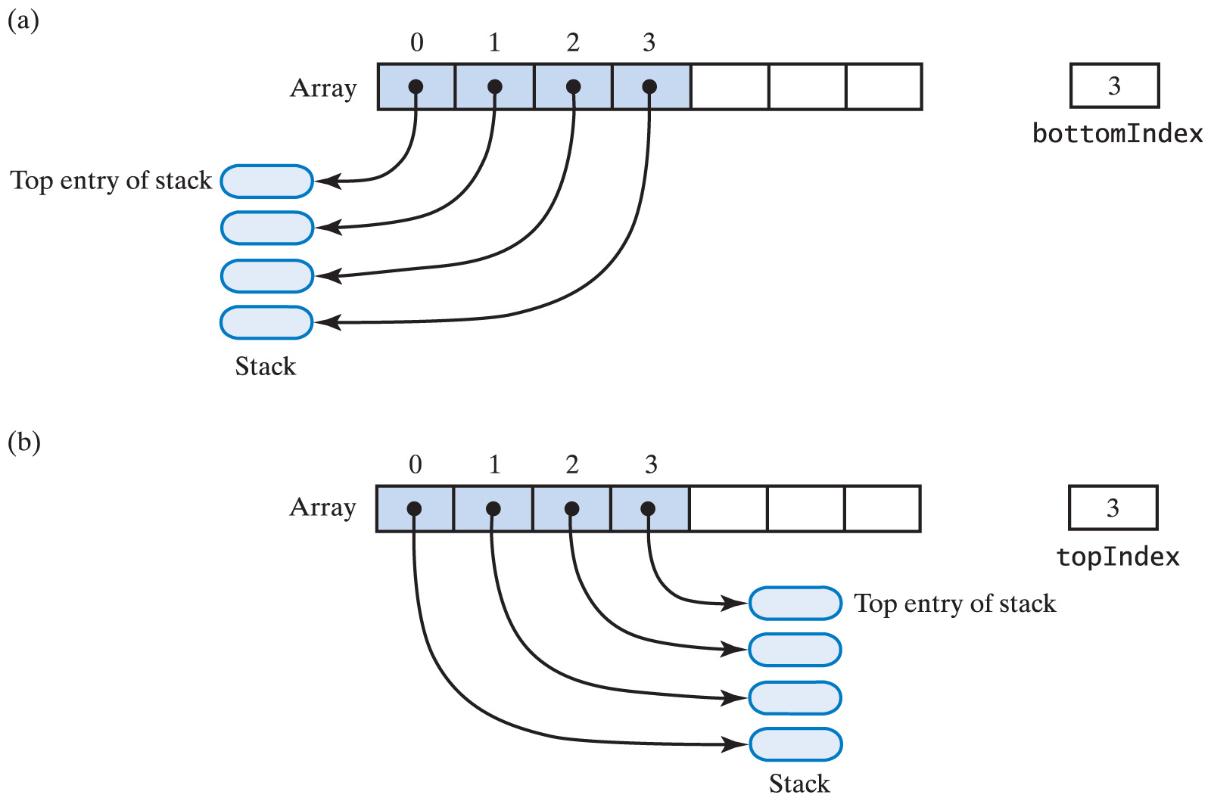
An Array-Based Implementation
Fig. 22-4 An array that implements a stack; its first location references (a) the top of the stack; (b) the bottom of the stack
Carrano, Data Structures and Abstractions with Java, Second Edition, (c) 2007 Pearson Education, Inc. All rights reserved. 0-13-237045-X

Slide 30
An Array-Based Implementation
View source code for array-based implementation of the ADT stack
Note methods
  push
  peek
  pop
  isEmpty
Carrano, Data Structures and Abstractions with Java, Second Edition, (c) 2007 Pearson Education, Inc. All rights reserved. 0-13-237045-X

Slide 31
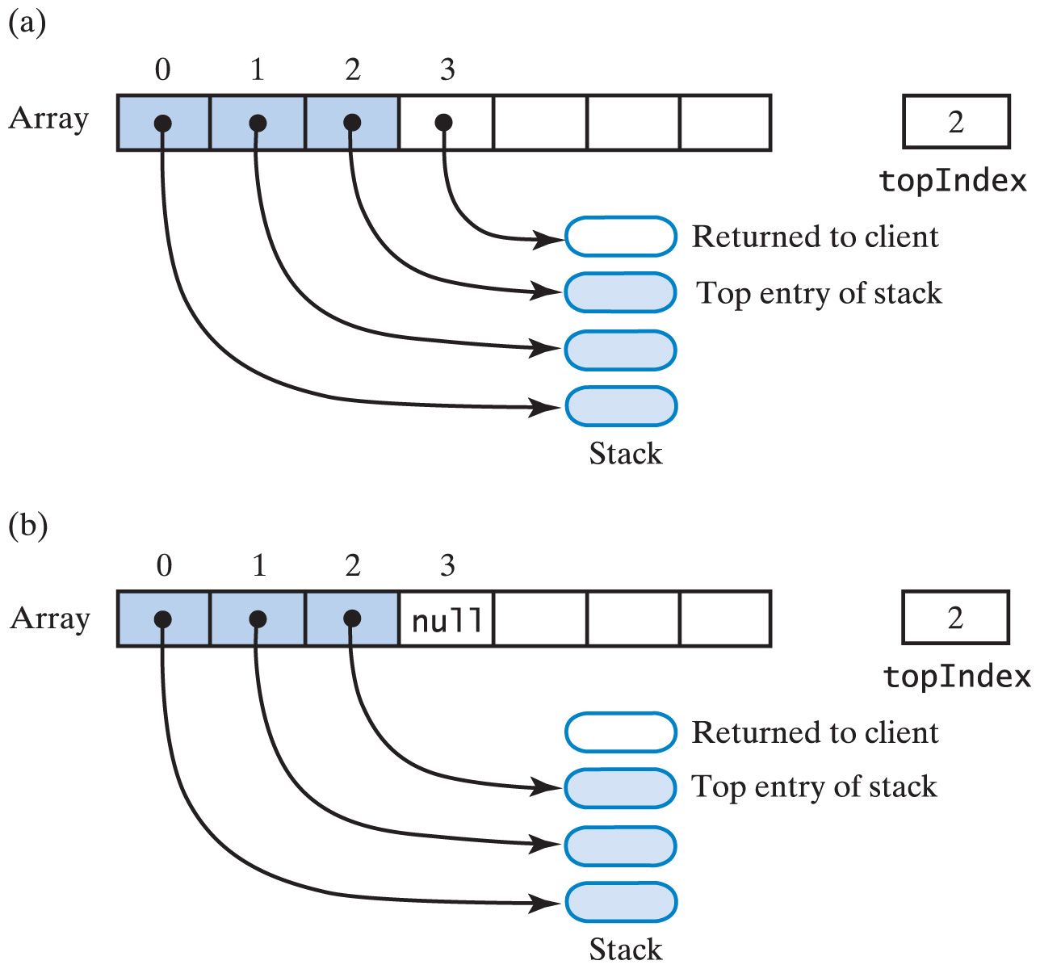
An Array-Based Implementation
Fig. 21-5 Another array-based stack after top removed by (a) decrementing topIndex;
Carrano, Data Structures and Abstractions with Java, Second Edition, (c) 2007 Pearson Education, Inc. All rights reserved. 0-13-237045-X

Slide 32
An Array-Based Implementation
Fig. 22-5 Another array-based stack after top removed by (b) setting stack[topIndex]=null and then decrementing topIndex
Carrano, Data Structures and Abstractions with Java, Second Edition, (c) 2007 Pearson Education, Inc. All rights reserved. 0-13-237045-X

Slide 33
A Vector-Based Implementation
When using a vector to implement a stack
  Vector's first element should represent the bottom of the stack
  Last occupied location in the vector represents the stack's top
Based on an array that can be expanded dynamically
  Performance similar to array-based implementation
Carrano, Data Structures and Abstractions with Java, Second Edition, (c) 2007 Pearson Education, Inc. All rights reserved. 0-13-237045-X

Slide 34
A Vector-Based Implementation
View source code for vector-based implementation of the ADT stack
Note methods
  push
  peek
  pop
  isEmpty
  clear
Carrano, Data Structures and Abstractions with Java, Second Edition, (c) 2007 Pearson Education, Inc. All rights reserved. 0-13-237045-X

